Slide 1
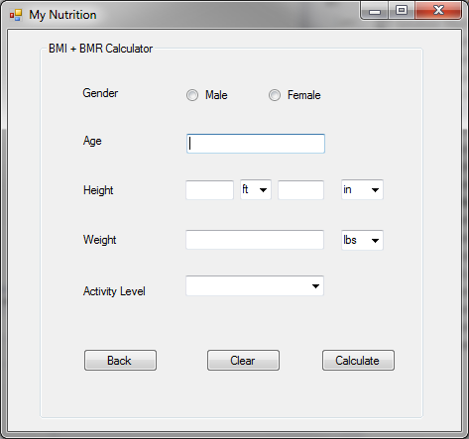
UI of BMI+BMR Calculator

Slide 2
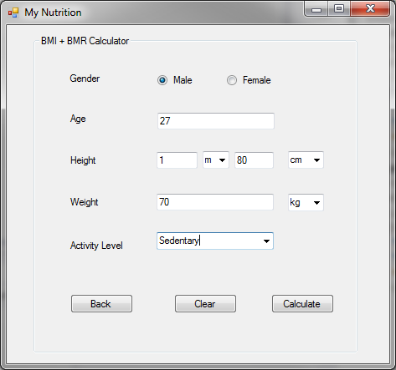
UI of BMI+BMR Calculator
Click Calculate

Slide 3
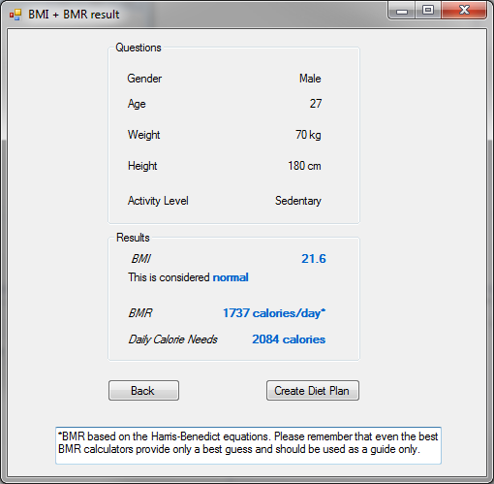
UI of BMI+BMR Calculator
Result We needed for Diet Plan

Slide 4
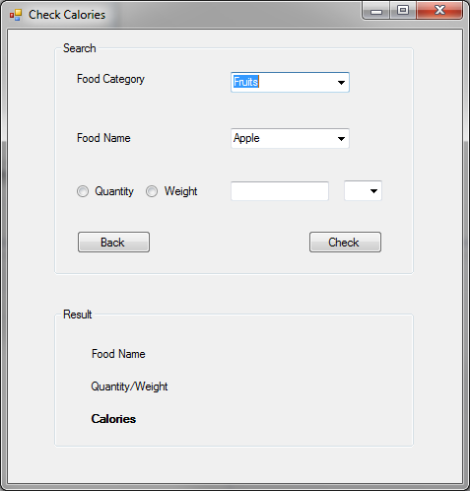
UI of Check Calories

Slide 5
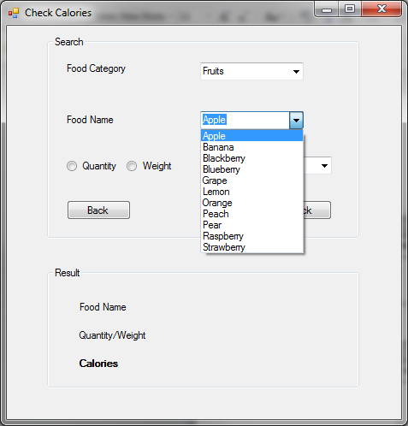
UI of Check Calories
Select Item from Dropdown List

Slide 6
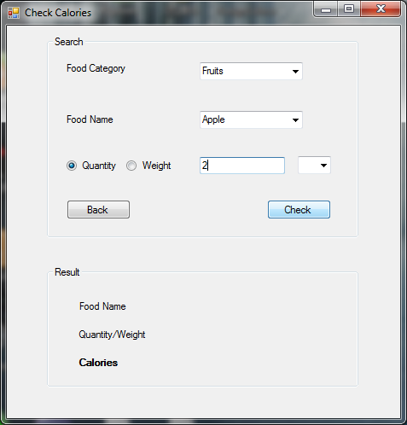
UI of Check Calories
Click Check

Slide 7
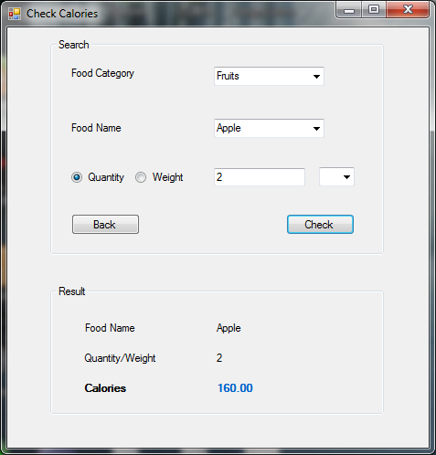
UI of Check Calories

